Slide 1
Student Council Voting System
Group Member Name:-
Kushal Amatya
Prashansa Sunuwar
Anurag Karki
Rohan Rana Magar
Student ID no.:-
4726
4713
4734
4735

Slide 2
Introduction
“Student Council Voting system” is the system that allows voter to easily vote their candidates and store the number of votes for individual candidates and also store the voters bio-data for administration.
This program can be associated to various devices.

Slide 3
Features
Casting single vote at a time.
Listing the total votes of each candidate.
Guessing the candidate who the voter thinks might win.
Listing the Leading Candidate.
Showing the administrator the data of the voter.

Slide 4
Advantages
Maintaining the candidate vote record.
Record the data of voters for further evaluation.

Slide 5
System Requirement
Minimum Hardware Requirements:-
PC with Pentium II Processor.
32 MB of RAM.
Black and White Monitor.
Hard disk with at least 20 MB of free space.
Minimum Software Requirement:-
OS Windows(Windows XP).

Slide 6
Recommended Hardware Requirements:-
PC with i3 Processor
100 MB of RAM.
LCD Monitor.
Hard disk with at least 100 MB of free space.
Recommended Software Requirement:-
OS Windows(Windows 7).

Slide 7
Scope and Limitation
Scope:
Secured data and security for voters privacy.
Limitation:
Staff training.
Customization features.
IT resource needed.
Lack of Remote accessibility.

Slide 8
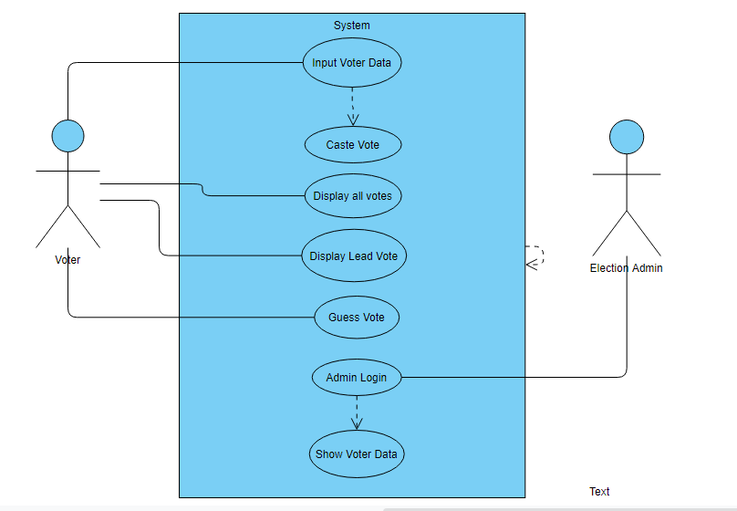
Use Case Diagram

Slide 9
Algorithm for Main
Step 1: Start.
Step 2: Initiate intro function.
Step 3: Initialize a variable.
Step 4: Display Main Menu having options:
Cast your vote.
Show total Vote Count.
Guess who is going to win the voting.
Show Leading Candidate.
Press 5 if you are the school administration.
Exit
Step 5: Get a choice and go to the chosen case.
Step 6: If user enters invalid choice then go to default case and display Please Enter correct choice.
Step 7: If choice is Exit go to Step 8 else go to Step 4.
Step 8: Stop.

Slide 10
Algorithm for Caste Vote Menu
Step 1: Start
Step 2: Create a data file Voter.dat in append mode.
Step 3: Get Name, Grade, ID number and Candidate Chosen.
Step 4: Store all variable in data file.
Step 5: Initialize vote counter for each candidate.
Step 6: If Candidate chosen is 1 then increase counter1 by 1 Elseif Candidate chosen is 2 then increase counter2 by 1 Elseif Candidate chosen is 3 then increase counter3 by 1 Elseif Candidate chosen is 4 then increase counter4 by 1.
Step 7: Close the data file Voter.dat.
Step 8: Stop.

Slide 11
Algorithm For Showing Vote Count
Step 1: Start.
Step 2: Display Candidate1 name and counter1.
Step 3: Display Candidate2 name and counter2.
Step 4: Display Candidate3 name and counter3.
Step 5: Display Candidate4 name and counter4.
Step 6: Stop.

Slide 12
Algorithm for Guessing vote
Step 1: Start.
Step 2: Initialize guessno as a variable.
Step 3: Get guessno.
Step 4: Create an array having counters as its element.
Step 5: Swap the counters inside the array in descending order and get the first element of the array after swap.
Step 6: If guessno is equal to the first element of the array, display Candidate is in the Lead position else display Candidate is not in the lead position.
Step 7: Stop.

Slide 13
Algorithm of Leading Candidate
Step 1: Start.
Step 2:Get counters for each candidate.
Step 3: If counter1>counter2>counter3>counter4 display Candidate1 is the Leading Candidate and goto Step 7.
Step 4: If counter2>counter1>counter3>counter4 display Candidate2 is the Leading Candidate and goto Step 7.
Step 5: If counter3>counter2>counter1>counter4 display Candidate3 is the Leading Candidate and goto Step 7.
Step 6: If counter4>counter2>counter3>counter1 display Candidate4 is the Leading Candidate and goto Step 7.
Step 7: Stop

Slide 14
Algorithm for Admin Panel
Step 1: Start.
Step 2: Initialize showvote as a variable.
Step 3: Get showvote from admin.
Step 4: Open the file Voter.dat in read only mode.
Step 5: Retrieve Name, Grade, ID number and Candidate Chosen from file and store them.
Step 6: If showvote is equal to Candidate Chosen display all Names, Grades and ID numbers that have the similar Candidate Chosen.
Step 7: Close the data file Voter.dat.
Step 8: Stop.

Slide 15
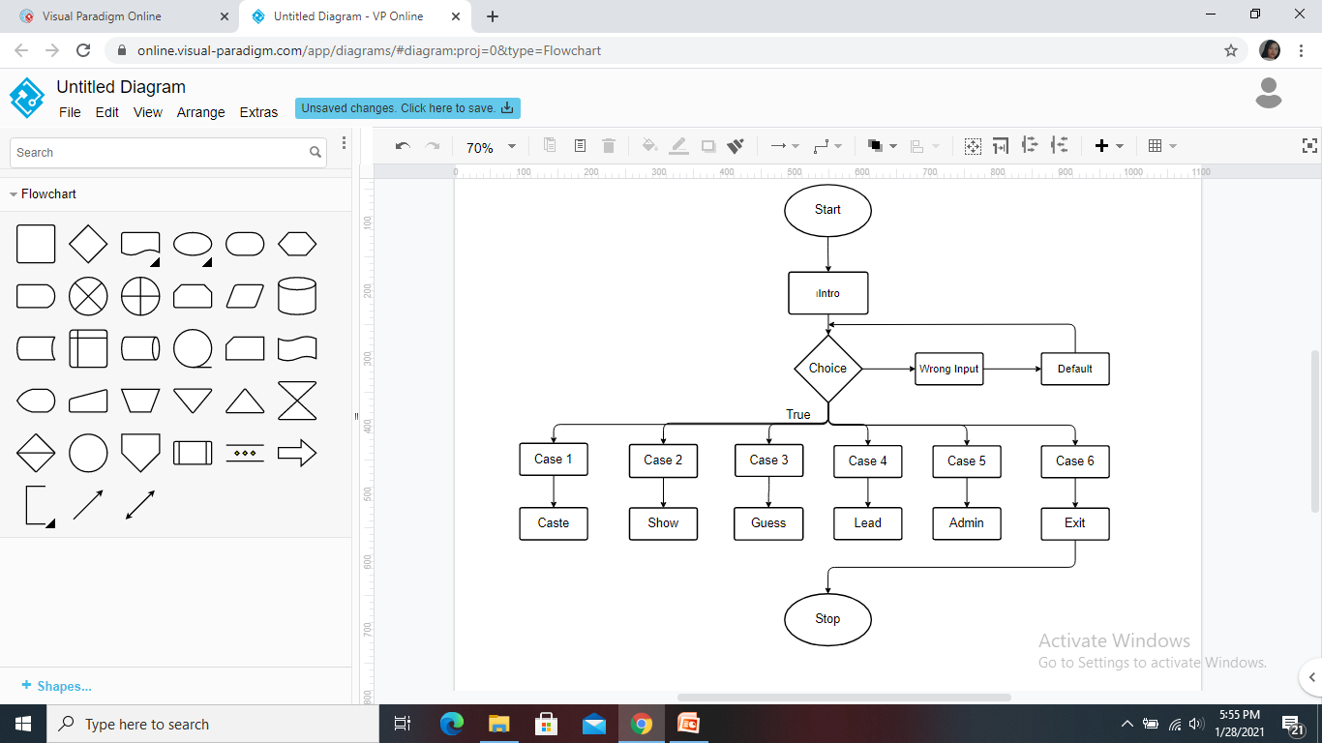
Flowchart of Main Menu

Slide 16
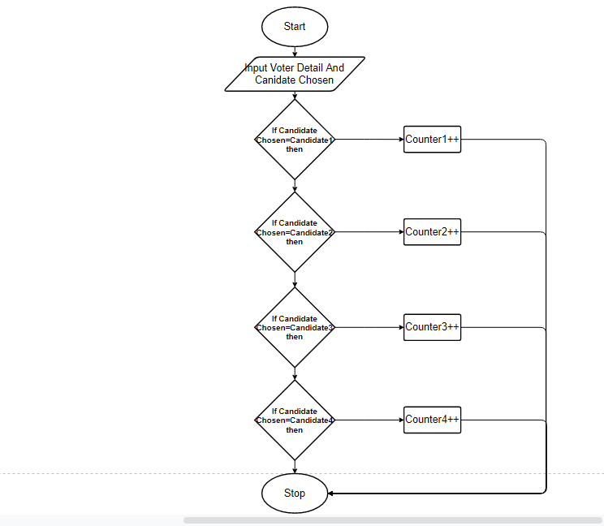
Flowchart of Cast vote

Slide 17
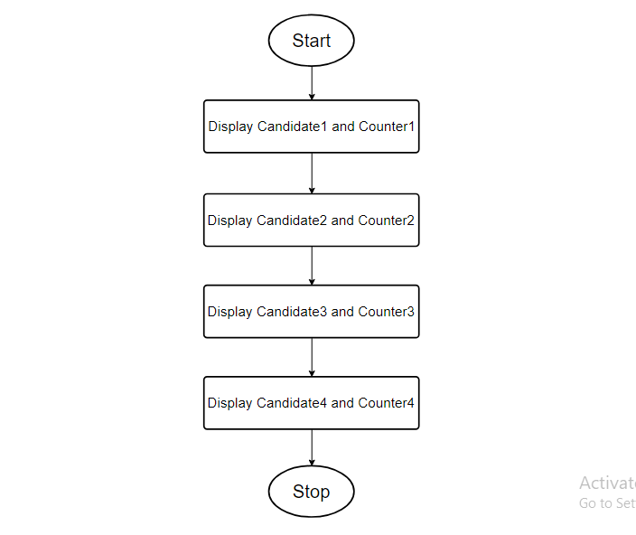
Flowchart for Showing Vote Count

Slide 18
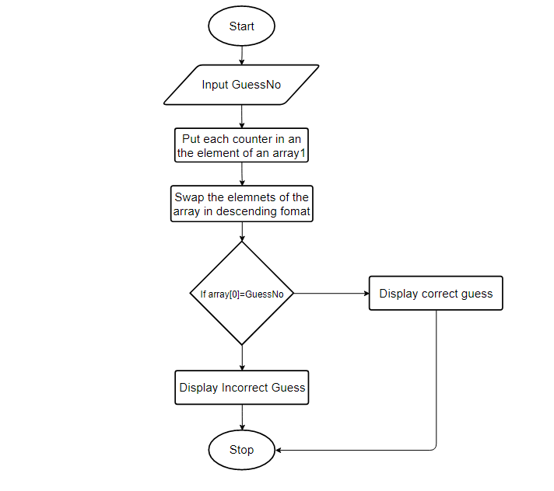
Flowchart of Guess leader

Slide 19
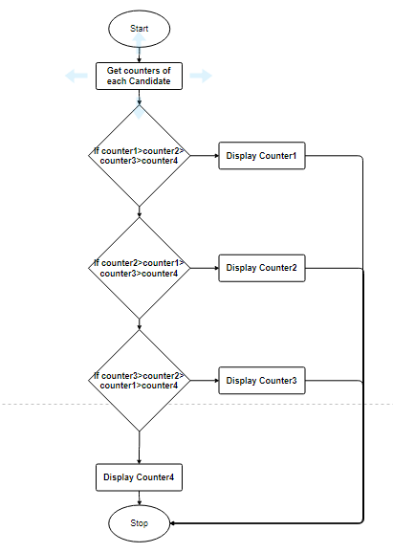
Flowchart of Lead count

Slide 20
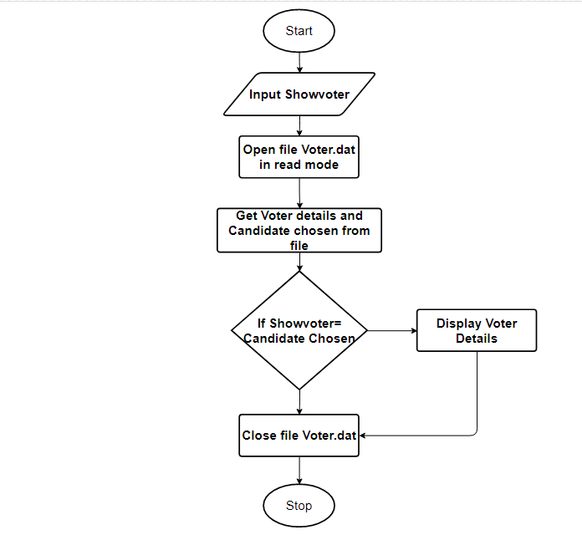
Flowchart For Admin Panel

Slide 21
Future Enhancement
Implementation of biometric security.
Implementation of nationwide online system.
Can be upgraded to advanced voting systems like political voting systems.

Slide 22
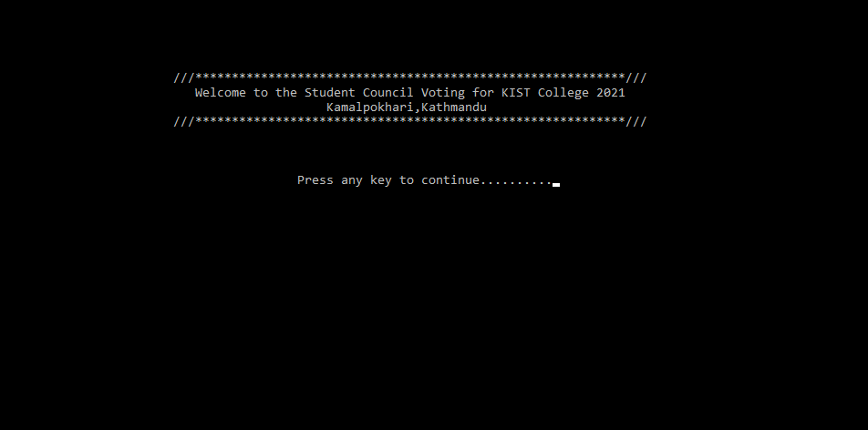
User Interfaces
Intro

Slide 23
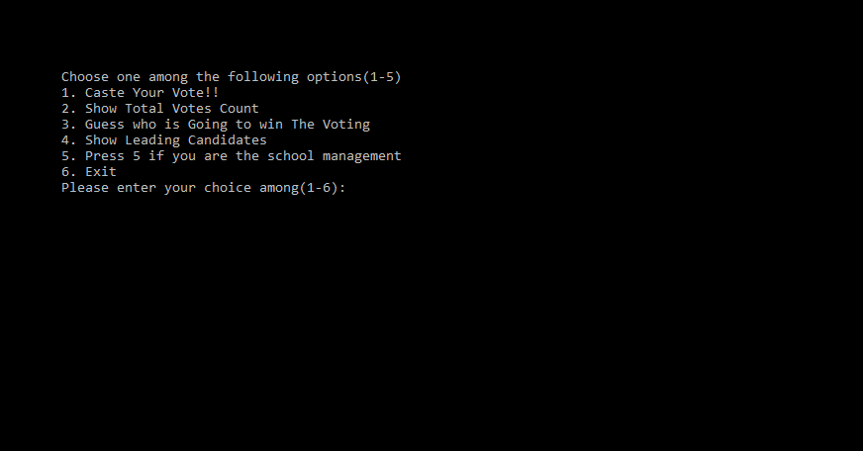
Main Menu

Slide 24
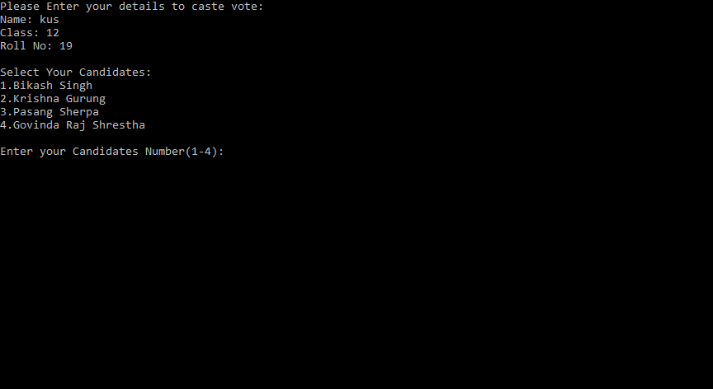
Caste Vote

Slide 25
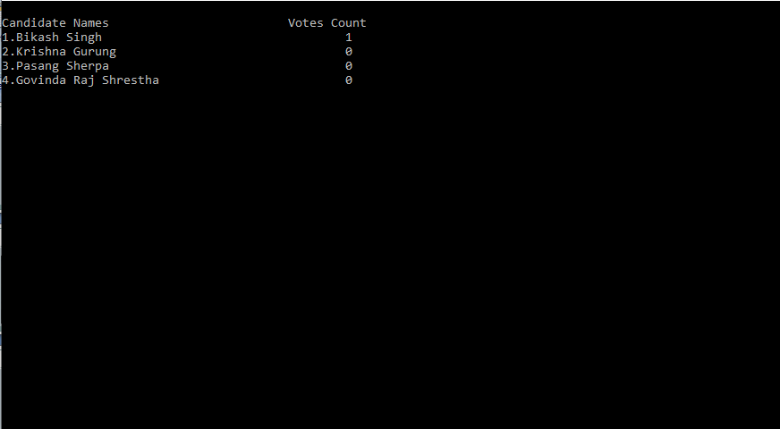
Show Total Vote Count

Slide 26
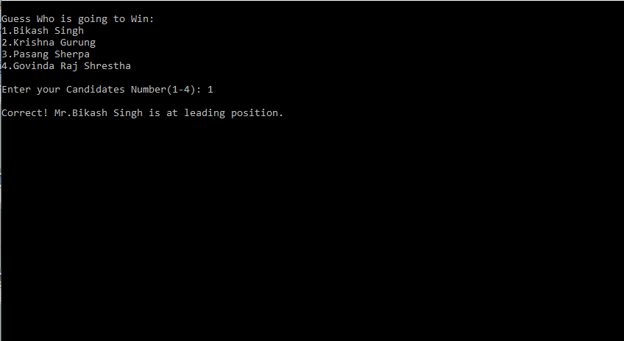
Guessing Who is going to Win

Slide 27
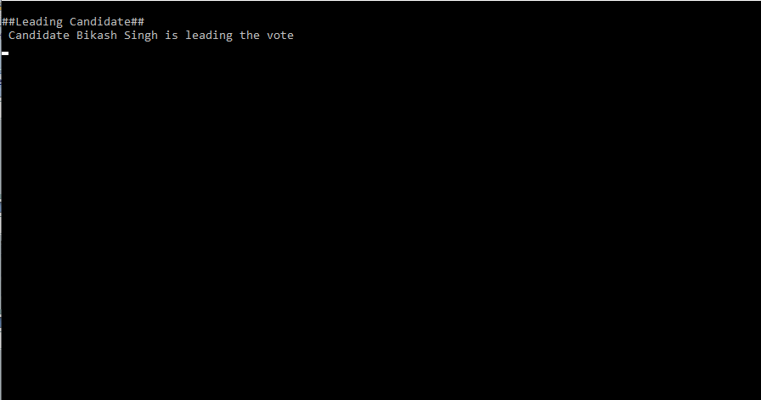
Show Leading Candidate

Slide 28
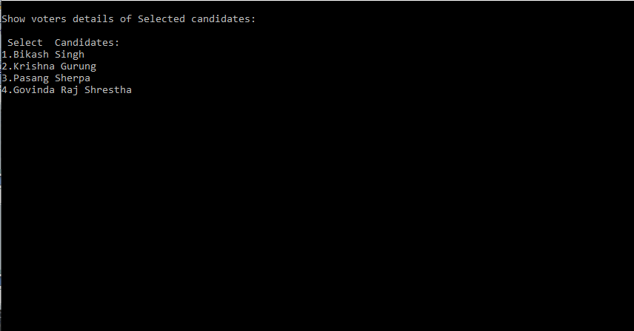
Admin Channel

Slide 29
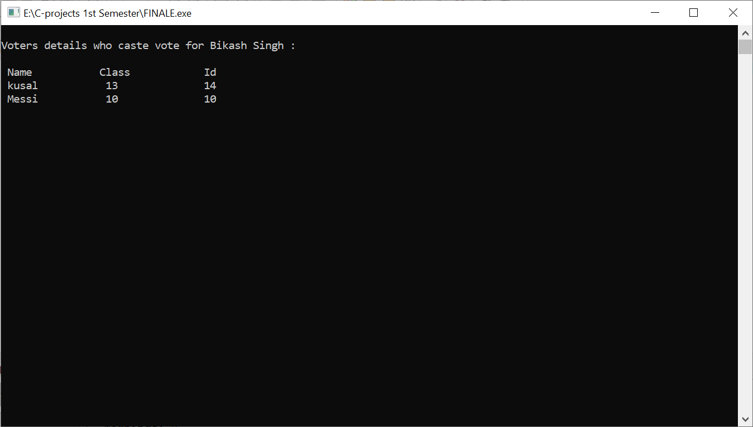
Admin Channel

